Slide 1
Smart Device Usage
By: Tyler Dussuau
Last updated: 02/09/2023

Slide 2
Business Task
We want to find trends and patterns in activity levels and physical attributes of Fitbit users to determine marketing strategies for Bellabeat products.

Slide 3
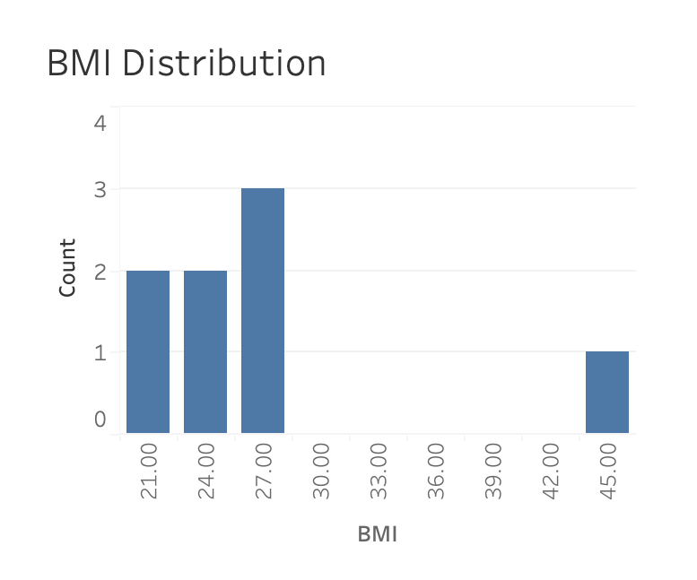
Body Mass Index
All users are in the upper range of a healthy BMI (21.7–24.9) or overweight (24.9 < BMI).
n = 8

Slide 4
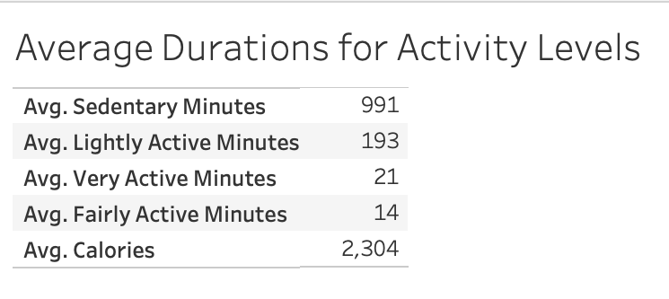
Activity Duration
Users are sedentary for more than 16 hours daily, on average.
n = 33

Slide 5
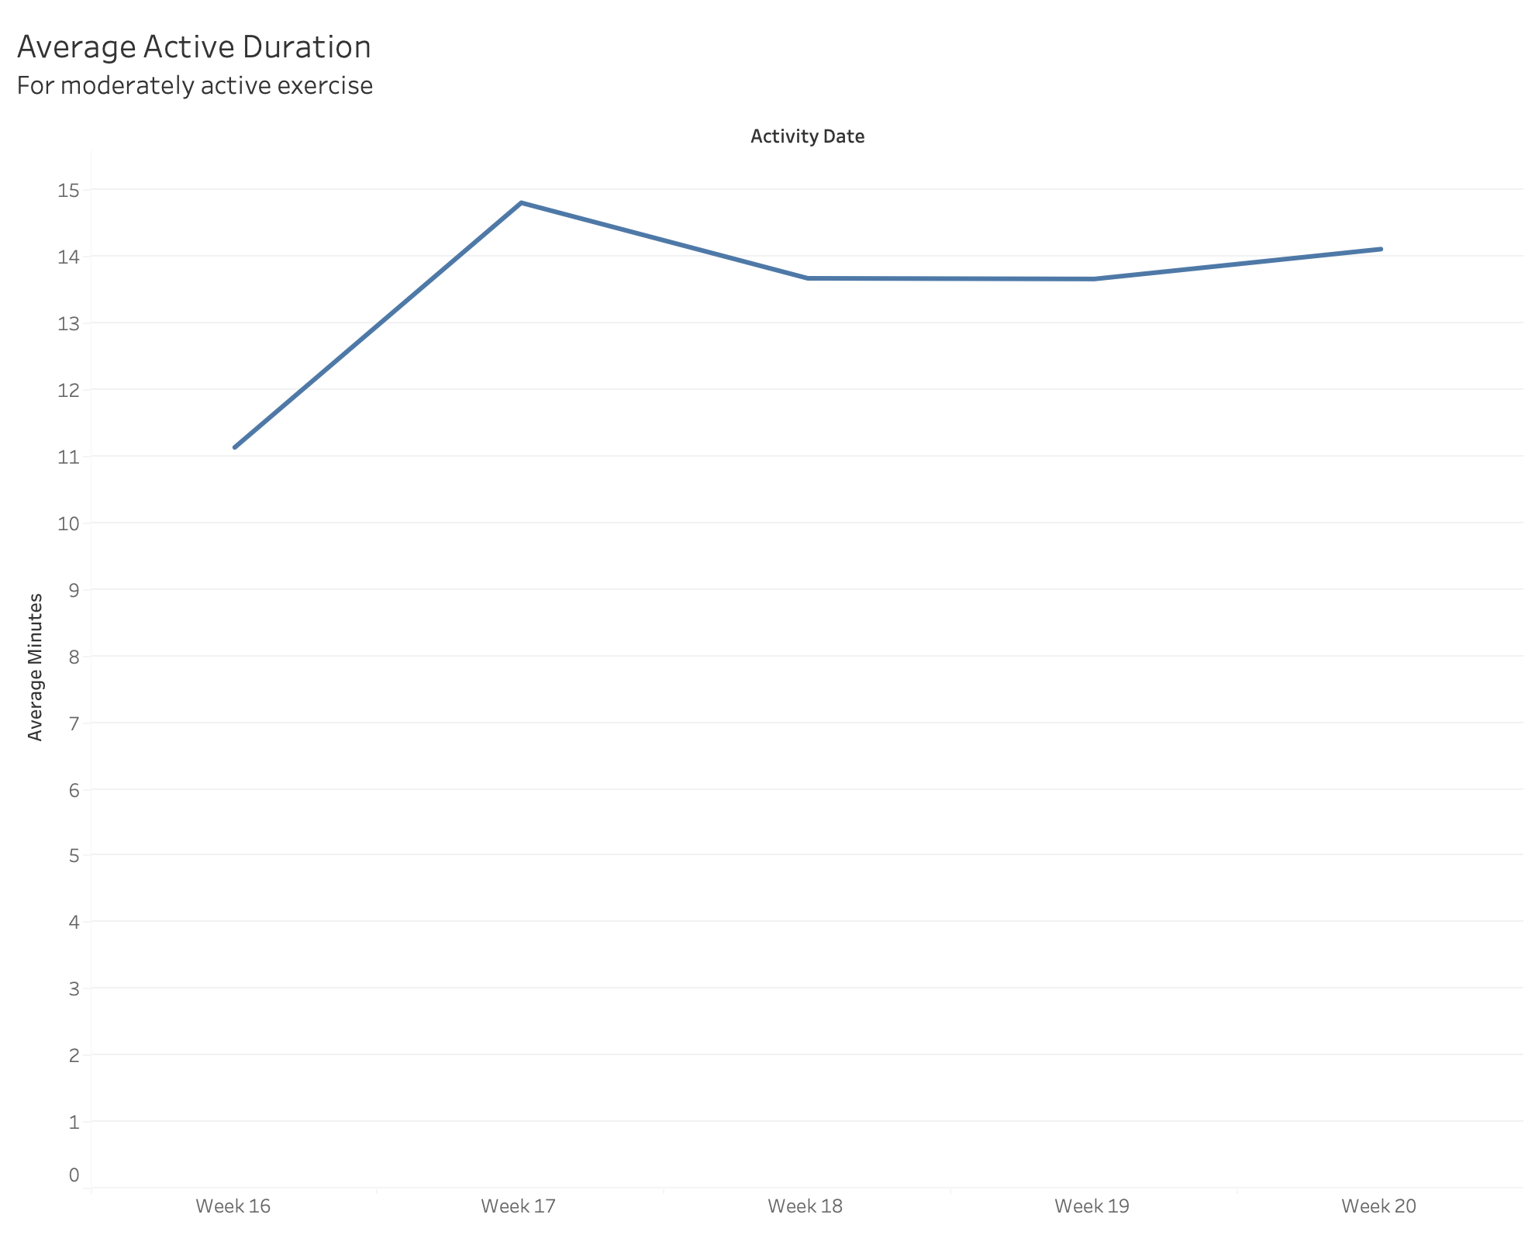
Activity Duration (cont.)
Users are only moderately active and very active for 13 minutes and 21 minutes, on average.
n = 33

Slide 6
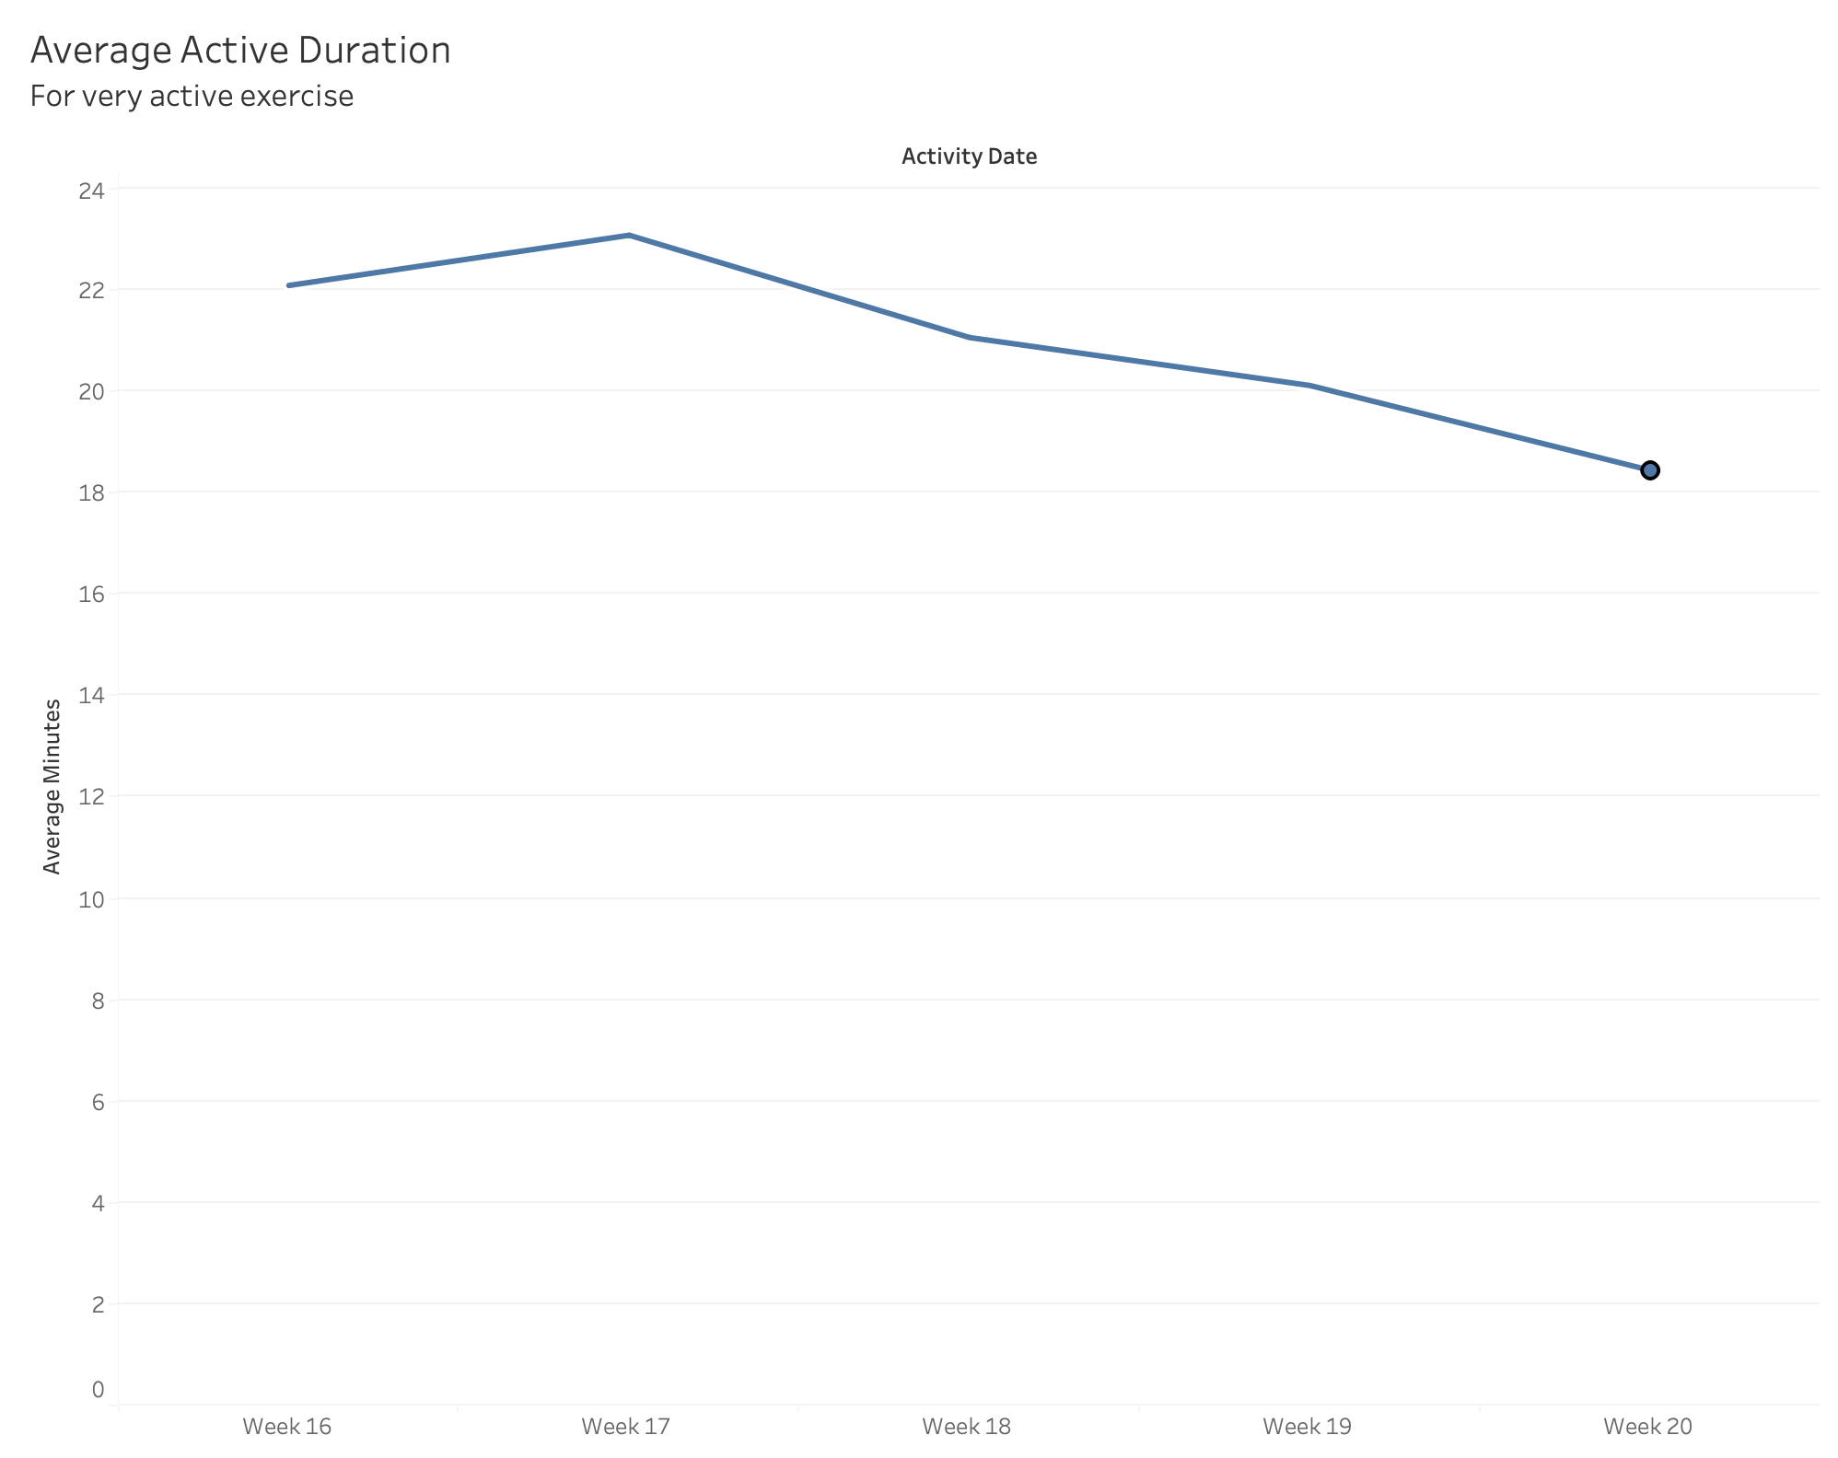
Activity Duration (cont.)
Users are only moderately active and very active for 13 minutes and 21 minutes, on average.
n = 33

Slide 7
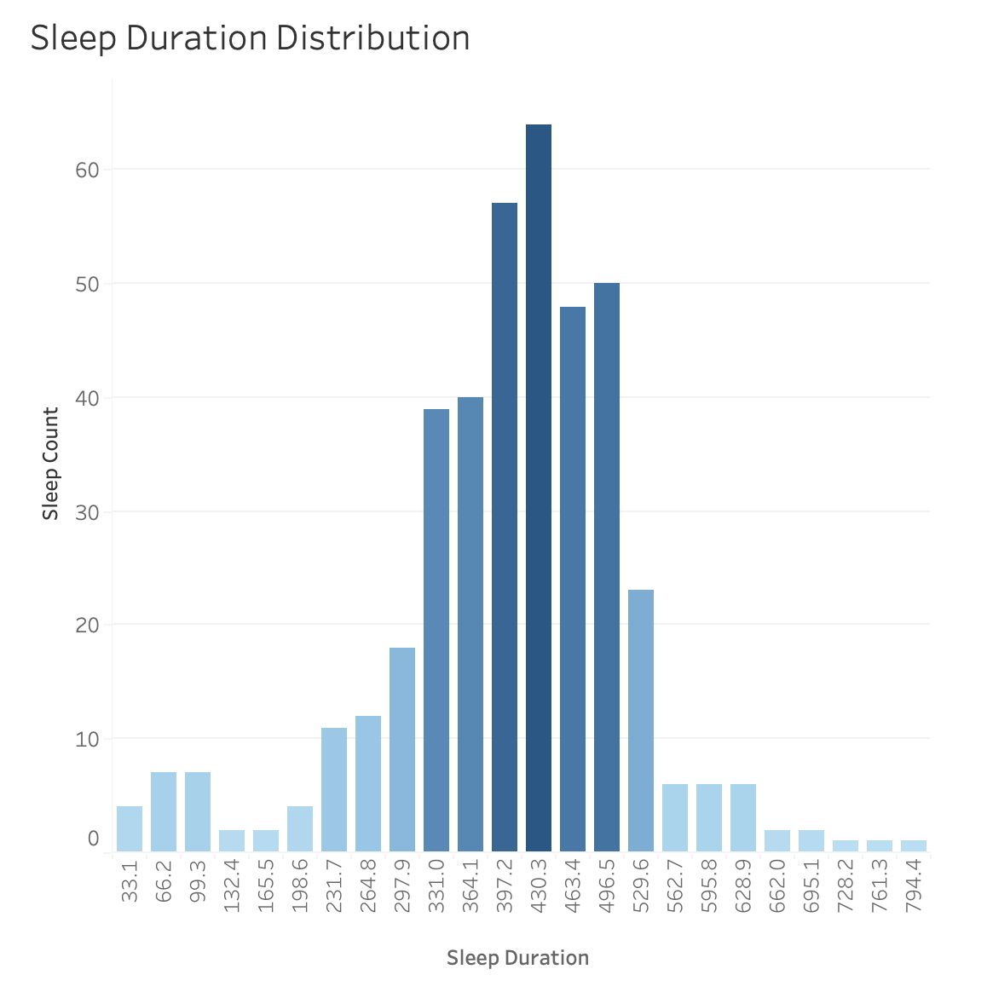
Sleep Duration
Most users sleep 5.5 hours (331 minutes) and 8.2 hours (495 minutes) daily.
n = 33

Slide 8
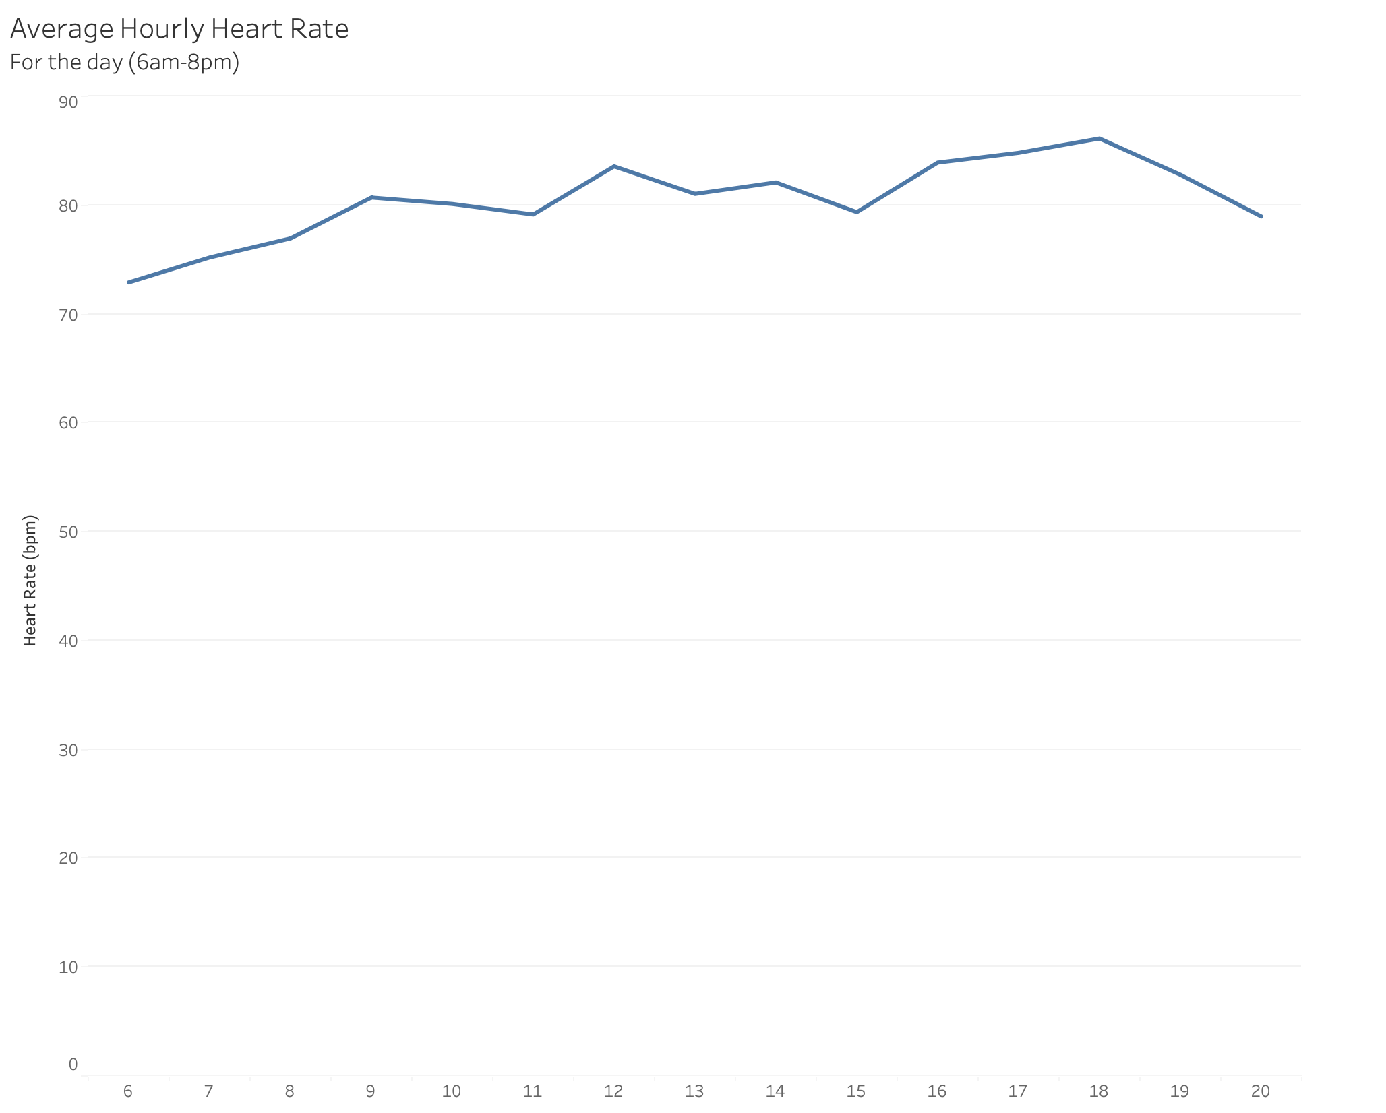
Heart Rate
Fitbit users tend to have healthy resting heart rates.
n = 14

Slide 9
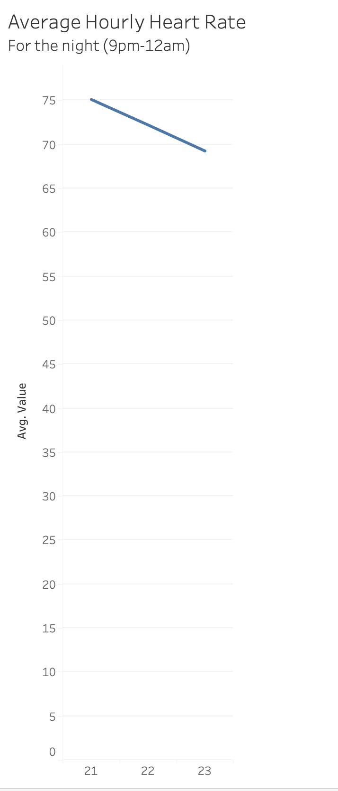
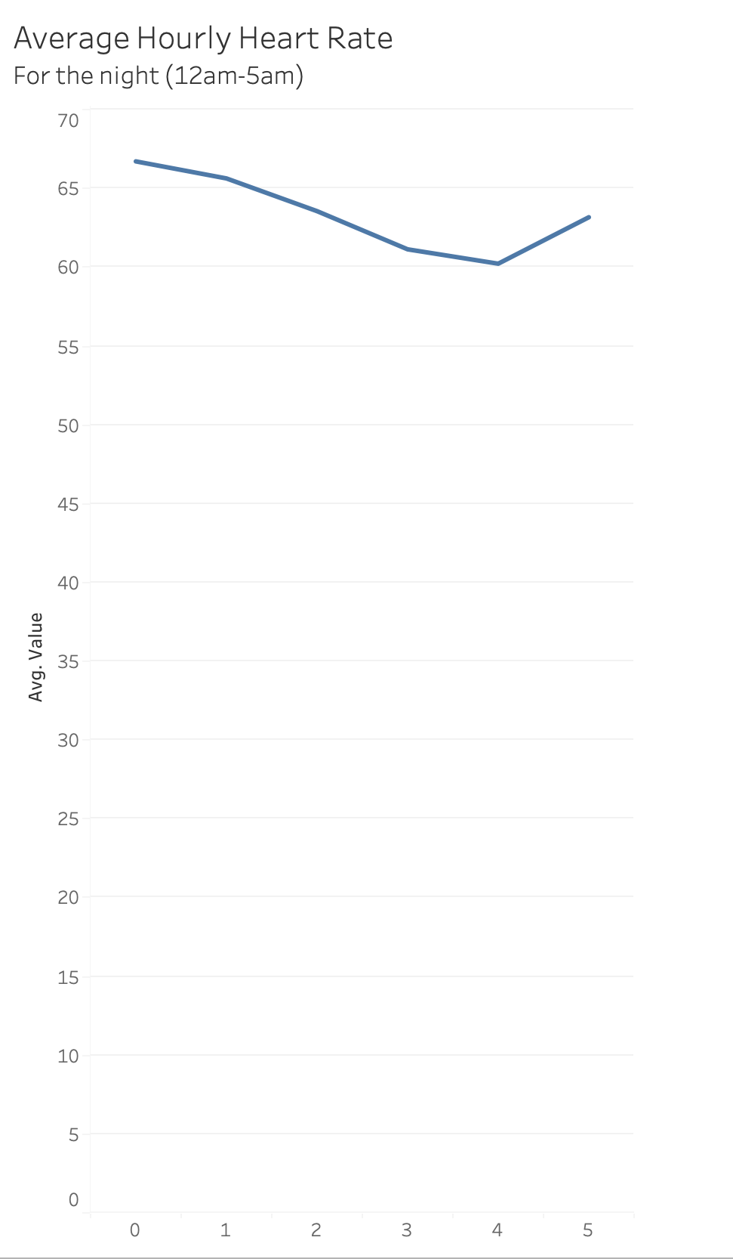
Heart Rate (cont.)
However, the average heart rate during sleep is slightly higher than normal.
n = 14

Slide 10
Recommendations
We should market towards people trying to lose weight or those who are helping other lose weight.
We should market how the Bellabeat Time can help users monitor and improve their stress and sleep patterns, especially during menstrual cycles.
The Bellabeat Time could be geared towards mothers who may only have time or energy for light activity. Advertisements on YouTube and Google for content related to motherhood is a possibility.

Slide 11
Thanks!

